Slide 1
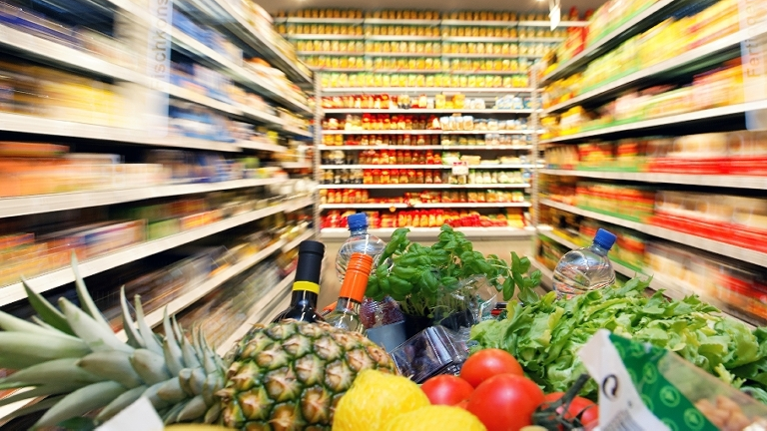
Prediction of Grain price for grocery market in the pandemic period
AIPI510 Final project
Team 9
Hank Chen
Ningwen hu
Florence Liu

Slide 2
Agenda
Background
CRISP-DM
Data Understanding
Data Preparation
Modeling
Evaluation
Data Privacy and Ethical Concern

Slide 3




Background
Some factors that affect the food price:
Pandemic
Climate change
World’s economy
?
Food Price
Notes:
During the pandemic period, food prices flutuated a lot. Consumers rushed to stock up on essential food items, which leads to higher food prices in grocery market. In addition, dramatic reduction in restaurant traffic and food service demand led to greater increase in demand at the retail level, which led to an increase in food price. Besides, unprecedented crisises on food price, such as climate change, the world’s economics are potential risk for grocery makets when pricing the food.

Slide 4
CRISP-DM
Business understanding
Define problems
Target user: Grocery market-Organize shelves and adjust prices every seven days
How can grocery market better price their grain prices under unpredictable crisis?
Define success
A cereal food index based on past data to predict general cereal food price in the next seven days.
Three metrics
R square | what proportion of the variation is explained by the regression
MSE | The average squared difference between the estimated values and the actual value
Visualize true value of test data and predication | Visually check the coincidence

Slide 5
Identify factors
Climate Change-Weather(We use “month” to represent the weather)
World's Economy-M2(a measure of the money supply)
Other factors with similar variation trends-the price of crude-oil, raw materials(coal, silver, copper, golden)

Slide 6
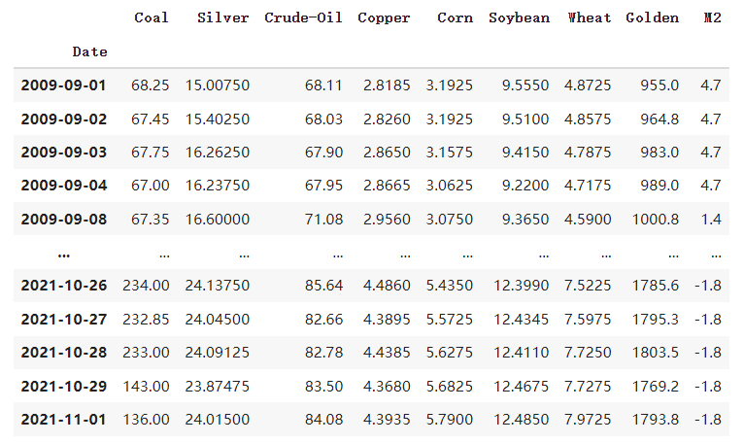
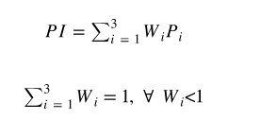
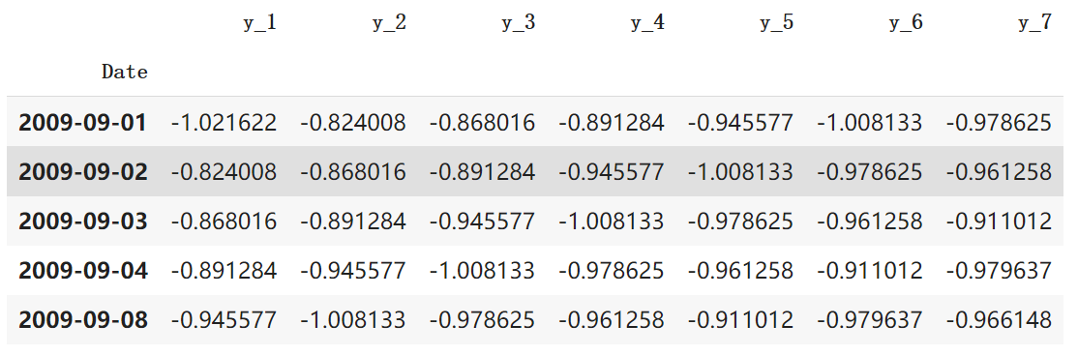
Data understanding
Combine data from different sources in one table:
Gather data
Data sources: USDA, Macrotrend, FRED Economic DATA
Combine data from different sources
Label data: Food Price Index(PI), calculated by weighted average price of corn, wheat and soybean
Food Price Index(PI)
The PI shows the 7 following days price.
Notes:
After we have determined our business problems and several factors. We search data on the internet to gather data of those factors. Our data comes from these data sources: USDA, Macrotrend and FRED economic data.
Then we combine data from different sources in one table based on date, as you can see the table here.
As our aim is to give a general indication of cereal price, we create a label data, food price index, using the weighted average price of corn, soybean, and wheat.

Slide 7
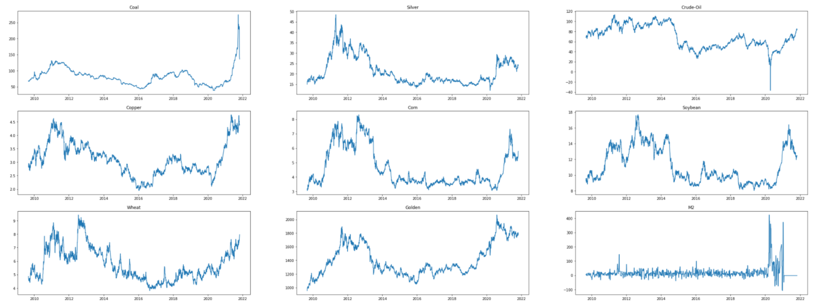
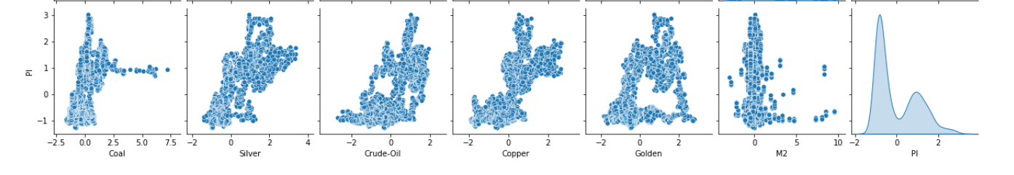
Validate & Explore data
Visualize Data
Display each features’ trend to detect outlier
Display a pairplot to look at relationships between PI and 6 features
Notes:
To know the trend of each feature, we display them respectively. As pictures shown here, it seems that the price of corn, copper, silver, soybean and golden are highly correlate by visual. Besides, we can obviously detect an outlier in the crude oil graph.
Then we normalize the data and pair plot it to look at the relationships between PI and 6 features. As the result shows here, the silver, crude oil and copper has a high correlation with PI.

Slide 8
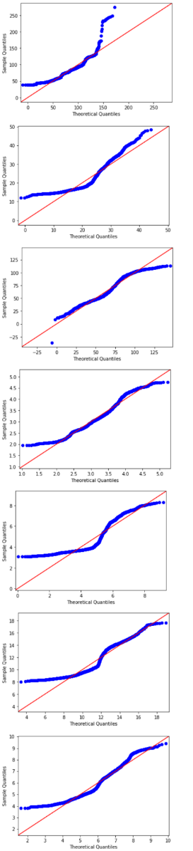
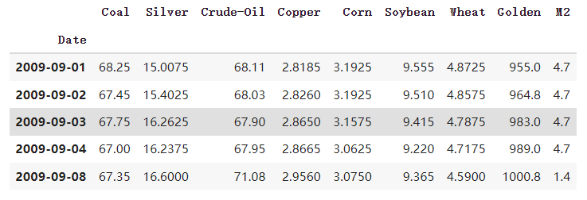
Outlier Detection:
Null values:
For M2, we use the weekly data to fill out the value in each day within that week.
For other null values, we defined them as “missing completely at random”, so we drop them directly.
QQ-plot
set k=2 to use IQR to filter out outliers
Time series:
As we want to give a 7-day prediction cereal price index for grocery market, we choose to build the time series model.
Notes:
Then we begin to deal with outliers and do some cleaning with missing data. First, we use QQ-plot to detect if our data set fits into the normal distribution. However, as the result shows here, none of our features follow that pattern. Therefore, we determined to use IQR to filter out the outliers. As we are capturing the data during the time when food price fluctuates a lot, we don’t want to treat huge fluctuations as outliers. Therefore, we set k=2 to filter out outliers.
To deal with null values, as for M2, we only have weekly data, so we use weekly data to fill out the value in each day of that week. For the other null values, we defined them as” Missing completely at random”, Thus, we delete them directly.
Finally, as our goal is to give a 7-day prediction of cereal price. And all of our data are gathered based on date, Therefore, we choose to use time series model to forecast future price.

Slide 9
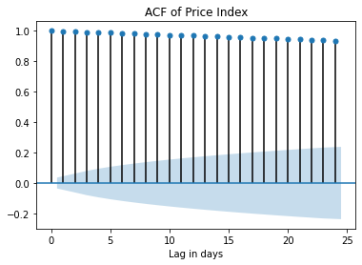
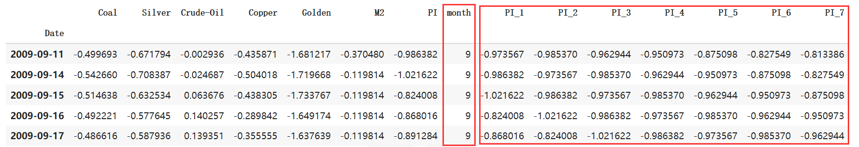
Data preparation
Data Normalization & Feature creation
Z-Score
Time Series Features
Month
Auto-correlation
Notes:
1.6,1.8,1.9
Add 2 features: month( using to add seasonal feature), PI( to capture some auto-correlation inside data)
After dealing with the outliers, we first normalized our data for further analysis. We use z-score normalization so that our data will have mean 0 and standard deviation 1 after the normalization. Then, we believe that price index is a value that is strongly related to time. So we want to add some time series features in our model. Thus, we first add the month as a feature. It is straightforward since the harvest of grains are related to month, and thus should be reflected in the price. Then, we believe there should be strong auto-correlation within our price index, so we plot the acf of PI. It demonstrates pretty strong autocorrelation. For the simplicity of modeling, we only pick the lag of seven days to be our features.

Slide 10
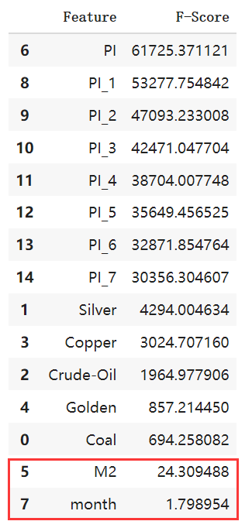
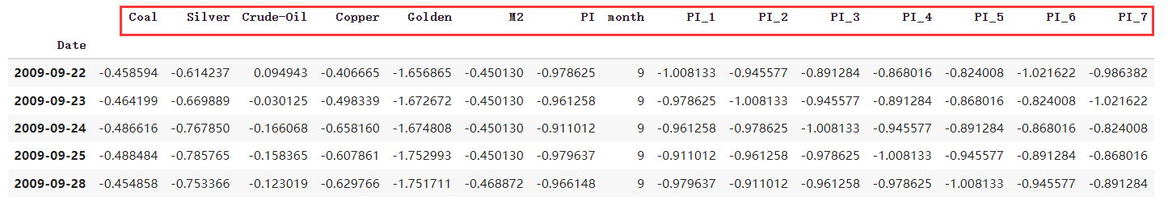
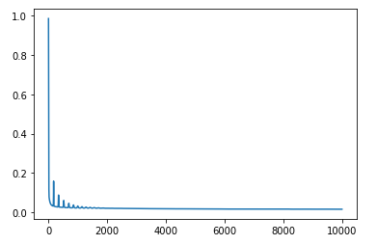
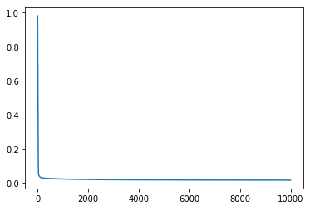
Data preparation
Feature Selection & Split the Data
Training Curve with 15 Features
Training Curve with 13 Features
Notes:
After adding the time series features, now we have a bunch of 15 features and we want to reduce some features to make our model more robust. Thus, we performed the univariate selection method and calculated the f-score of eThe training curve of the model containing the whole 15 features shows more fluctuation comparing to the model after the reduction of feature. And finally, our predictors are these 13 features, and we use 30% of the data as testing data.ach variable. We remove the last two variables and see immediate improvement in the training curve.

Slide 11
Modeling
Input Layer
ReLU
Output Layer
Features
Predictions
SGD + MSE
ReLU
Hidden Layer
Notes:
We apply a three layer fully connected neuron network as our model. The input layer has 13 cells, each corresponding to a input feature, and the output layer includes 7 cells, each is associated with the price index of a day. ReLU function is used as activation function to address the gradient diminishing and explosion issue. We use Stochastic gradient descent method to accelerate the training process and use mean square error as loss function.

Slide 12
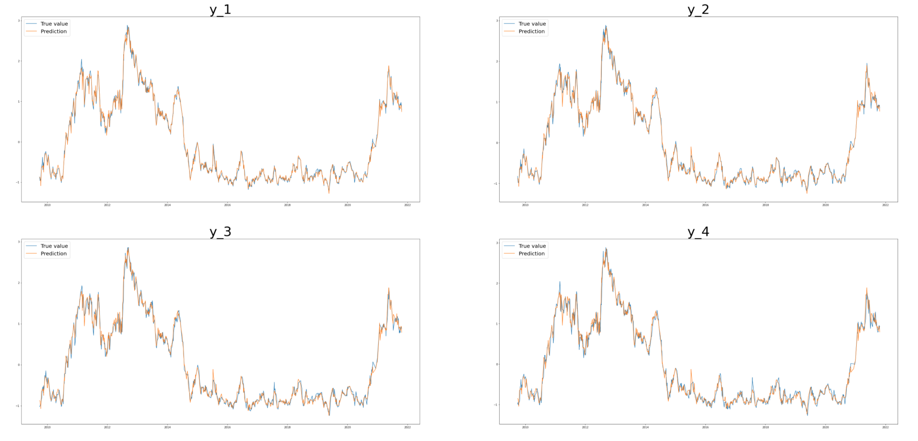
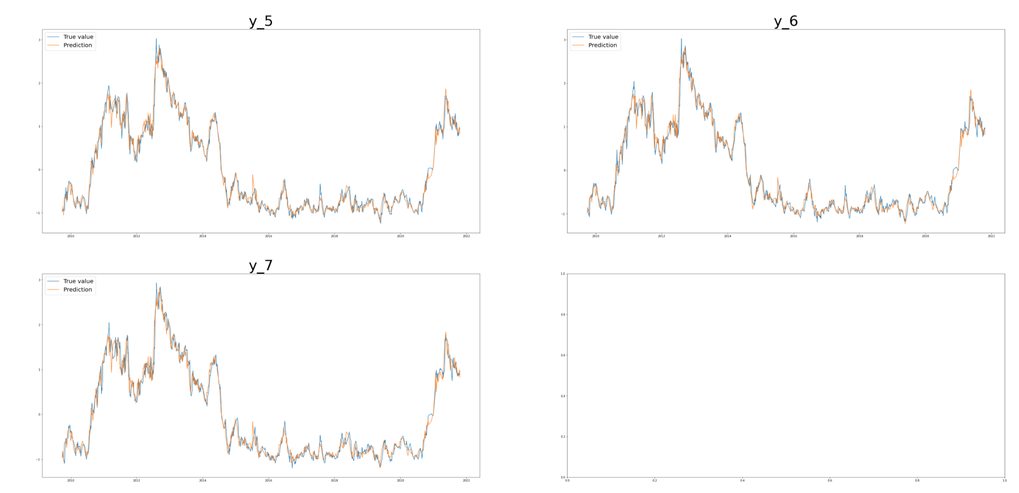
Evaluation
Visualize true value of test data and predication next 7 days-y1,y2,y3,y4,y5,y6,y7
Notes:
3 强调outcomes

Slide 13
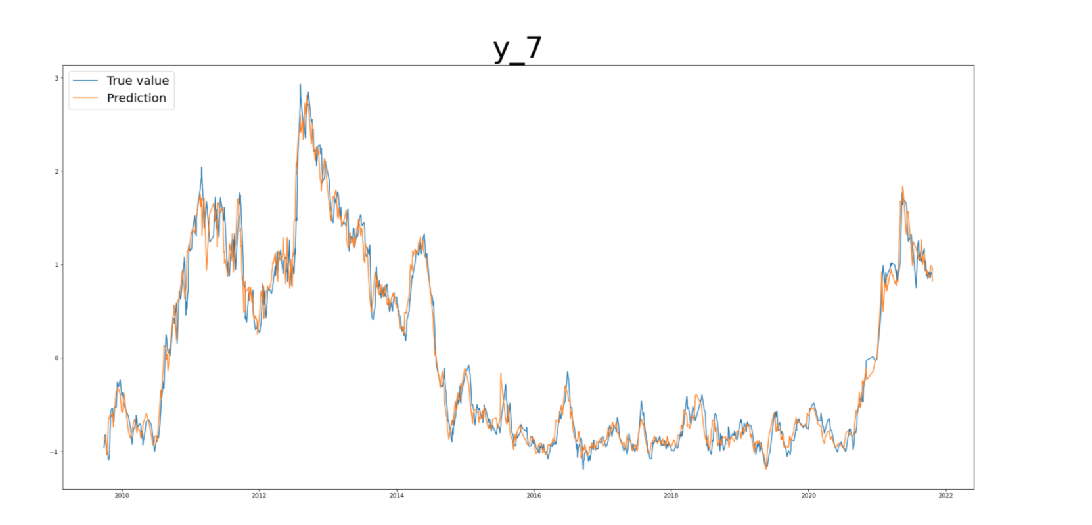

Slide 14
R square & MSE
Forecasts Days | R square | MSE
Next 1 day | 0.994 | 0.0058
Next 2 days | 0.990 | 0.0098
Next 3 days | 0.987 | 0.013
Next 4 days | 0.983 | 0.018
Next 5 days | 0.978 | 0.022
Next 6 days | 0.974 | 0.026
Next 7 days | 0.971 | 0.029

Slide 15
Data privacy and ethical consideration
Data Privacy-Factor to Determine which rules to Apply
Is the information “Personally-identifiable” (PII)?
Is your data legacy data or new data gathered from current users?
Is a Protected Industry Sector Involved?
Are Children Involved?
Ethical Consideration
Suitable for future qualitative analysis rather than specific quantity
Influence of other features may be covered by features selected by Time Series with high correlation

Slide 16
THANK YOU
Q&A

